Slide 1
PHYSICAL CONTEXT
Module Exercise

Slide 2



BACKGROUND
In this session you should apply the fundamentals of how to arrange a classroom and manage group dynamics to facilitate an interactive learning experience for your audience. The way the room is set up will influence the interaction within the group and the participants’ learning process.
Think about applying the concept of space management to exercise Setting Priorities of TEAMS Training Package. Remember to apply the concepts learnt in the Module “Physical Context”
https://www.teams-project.eu/teams-training-package/

Slide 3

Considerations
Before starting this exercise, please take into consideration the following elements:
Human resources
3 trainers
(one of them will be the training manager)
2 facilitators
19 participants
receiving training
Printed cards with patients and resource
Material

Slide 4

Scenario of exercise 3
During this exercise the EMT members will be confronted with patients in very critical conditions and a set of resources to treat these patients. The team will have to decide how to allocate the available resources in order to save the highest number of patients. A role player will also intervene during the exercise, taking the role of a father whose child is admitted within the EMT facility in a critical state. The team members will have to deal with the father while rapidly decide on the treatment to the critical patients, whose state will change and worsen as the exercise advances.
The purpose of this exercise is to expose participants to ethical and conflicting decisions frequently encountered during EMT deployments. Emergency operations are marked by an imbalance between the huge needs and the scarcity of resources available. This lack of resources can sometimes have fatal consequences for patients that in normal conditions will survive. This imbalance means a high burden for EMT staff who has to take decisions in this difficult circumstances and face its consequences.

Slide 5
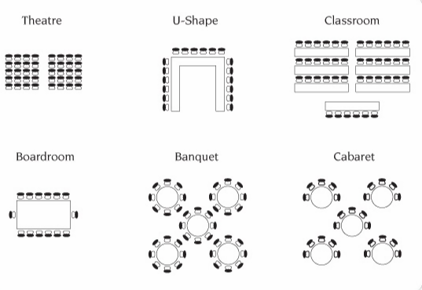
Setting Up the Physical Space for Training
Consider the following points when setting up the training space:
Theatre
U-Shape
Classroom
1. Table and chair arrangement
Select the appropriate setting from the image on the right
2. Disposition and quantity of flipcharts in the room
Where would you place the flipcharts? And how many of them?
3. Visuals
Which visuals would you hang on the wall?
Boardroom
Banquet
Cabaret

Slide 6
Group Dynamics
Participants look bored and tired, with two participants taking the lead and constantly interrupt presentations and discussions. The latter keep on talking, providing their opinion, even though the trainer already asked them to give space also to other participants.
What would you do?
Which techniques would you use to generate ideas and facilitate interactions?
Would you need a different table disposition?
If you realize the room set up is not appropriate, what would you do?
Notes:
When people from different backgrounds and life experiences meet to go through an intense learning event, there will inevitably be various reactions. Some might sit back, others will fully engage, and there will be some who will adopt blocking roles. This is a natural response to some sessions or specific tasks, so it is important that trainees be prepared to handle such situations.
Managing the attention and energy of people in the room is an essential responsibility of trainers. Beyond generic tips on how to keep up engagement and monitor the energy/attention level in the room, consider space setting and if there are refreshments and water available for participants. Most of the time, the audience need a quick break, refreshments, an interesting energizer game and attention is back again!

Slide 7
Methods to facilitate interaction within a group
In pairs, triads and bigger groups
One-way
presenting
To which part of exercise 3 would you apply the following presentation style to convey scenario and information on exercise 3?
Working in groups
Individual reflection
Plenary discussion (with the whole group)

